Slide 1
Arhitecturi Paralele Pthread + Primitive sincronizare
Lect. Dr. Ing. Cristian Chilipirea
cristian.chilipirea@mta.ro
Curs susținut în parteneriat cu Prof. Florin Pop

Slide 2
Tipuri de paralelism
La nivel de bit (Bit level)
La nivel de instrucțiune (Instruction level)
La nivel de task (Task parallelism)

Slide 3
Tipuri de paralelism
Bit level
C = A & B
Instruction level
Task parallelism

Slide 4
Tipuri de paralelism
Bit level
Instruction level
C[] = A[] + B[]
Task parallelism
9
6
9
4
2
7
Adunarea a doi vectori

Slide 5
Tipuri de paralelism
Bit level
Instruction level
Task parallelism
Multi-Tasking (pot comunica și procesele)
Multi-Threading
load Z |  | A = B + C
store H | . | store A
H=H*100 | . | G[1] = G[2] + G[3]
H++ | . | store G[1]
store H |  | G[4] = G[5] + G[6]

Slide 6
Tipuri de paralelism
Bit level
Instruction level
Task parallelism
Multi-Tasking (pot comunica și procesele)
Multi-Threading
Cum pot comunica două procese?

Slide 8
Notații pseudocod
co S1 || S2 || ... || Sn oc
Ex.1:
x=0; y=0;
co x=x+1 || y=y+1 oc
z=x+y;

Slide 9
Notații pseudocod
co [cuantificator]{Sj}
Ex. 2:
co [j=1 to n] {a[j]=0; b[j]=0;}

Slide 10
POSIX threads

Slide 11
POSIX threads
pthread_t thread;
pthread_create(&thread, NULL, threadFunction, arg);
void * threadFunction(void* arg)
{
}
pthread_join(thread, NULL);

Slide 12
Compilare pthread
gcc –o executabil cod.c –lpthread –lrt
#include<pthread.h>
#include<semaphore.h>

Slide 13
Pthread
pthread_t thread;
pthread_create(&thread, NULL, threadFunction, arg);
void * threadFunction(void* arg)
{
}
pthread_join(thread, NULL);
Acest element reprezintă thread-ul.
Este un thread handle

Slide 14
Pthread
pthread_t thread;
pthread_create(&thread, NULL, threadFunction, arg);
void * threadFunction(void* arg)
{
}
pthread_join(thread, NULL);
Prin acest parametru am putea să facem recomandări sistemului de operare.
Ex: să folosească anumite core-uri.

Slide 15
Pthread
pthread_t thread;
pthread_create(&thread, NULL, threadFunction, arg);
void * threadFunction(void* arg)
{
}
pthread_join(thread, NULL);
Când se crează thread-ul va porni de la funcția dată ca parametru.

Slide 16
Pthread
pthread_t thread;
pthread_create(&thread, NULL, threadFunction, arg);
void * threadFunction(void* arg)
{
}
pthread_join(thread, NULL);
Așa trimitem date thread-ului

Slide 17
Pthread
pthread_t thread;
pthread_create(&thread, NULL, threadFunction, arg);
void * threadFunction(void* arg)
{
}
pthread_join(thread, NULL);
Astfel se pot extrage date din thread

Slide 19
Pthread
int main(int argc, char **argv)
{
int i, P=2;
pthread_t tid[P];
for(i = 0; i < P; i++) {
pthread_create(&(tid[i]), NULL, threadFunction, NULL);
}
for(i = 0; i < P; i++) {
pthread_join(tid[i], NULL);
}
return 0;
}

Slide 20
Pthread
int main(int argc, char **argv)
{
int i, P=2;
pthread_t tid[P];
for(i = 0; i < P; i++) {
pthread_create(&(tid[i]), NULL, threadFunction, NULL);
}
for(i = 0; i < P; i++) {
pthread_join(tid[i], NULL);
}
return 0;
}

Slide 21
Pthread
int main(int argc, char **argv)
{
int i, P=2;
pthread_t tid[P];
for(i = 0; i < P; i++) {
pthread_create(&(tid[i]), NULL, threadFunction, NULL);
}
for(i = 0; i < P; i++) {
pthread_join(tid[i], NULL);
}
return 0;
}

Slide 22
Pthread
int main(int argc, char **argv)
{
int i, P=2;
pthread_t tid[P];
for(i = 0; i < P; i++) {
pthread_create(&(tid[i]), NULL, threadFunction, NULL);
}
for(i = 0; i < P; i++) {
pthread_join(tid[i], NULL);
}
return 0;
}

Slide 23
Pthread
int main(int argc, char **argv)
{
int i, P=2;
pthread_t tid[P];
for(i = 0; i < P; i++) {
pthread_create(&(tid[i]), NULL, threadFunction, NULL);
}
for(i = 0; i < P; i++) {
pthread_join(tid[i], NULL);
}
return 0;
}

Slide 24
Pthread
void* threadFunction(void *arg)
{
a=a+1;
return NULL;
}
int main(int argc, char **argv)
{
int i, P=2;
pthread_t tid[P];
for(i = 0; i < P; i++) {
pthread_create(&(tid[i]), NULL, threadFunction, NULL);
}
for(i = 0; i < P; i++) {
pthread_join(tid[i], NULL);
}
return 0;
}

Slide 25
Pthread
void* threadFunction(void *arg)
{
a=a+1;
return NULL;
}
int main(int argc, char **argv)
{
int i, P=2;
pthread_t tid[P];
for(i = 0; i < P; i++) {
pthread_create(&(tid[i]), NULL, threadFunction, NULL);
}
for(i = 0; i < P; i++) {
pthread_join(tid[i], NULL);
}
return 0;
}

Slide 26
Pthread
void* threadFunction(void *arg)
{
a=a+1;
return NULL;
}
int main(int argc, char **argv)
{
int i, P=2;
pthread_t tid[P];
for(i = 0; i < P; i++) {
pthread_create(&(tid[i]), NULL, threadFunction, NULL);
}
for(i = 0; i < P; i++) {
pthread_join(tid[i], NULL);
}
return 0;
}

Slide 27
Pthread
void* threadFunction(void *arg)
{
a=a+1;
return NULL;
}
int main(int argc, char **argv)
{
int i, P=2;
pthread_t tid[P];
for(i = 0; i < P; i++) {
pthread_create(&(tid[i]), NULL, threadFunction, NULL);
}
for(i = 0; i < P; i++) {
pthread_join(tid[i], NULL);
}
return 0;
}
void* threadFunction(void *arg)
{
a=a+1;
return NULL;
}

Slide 28
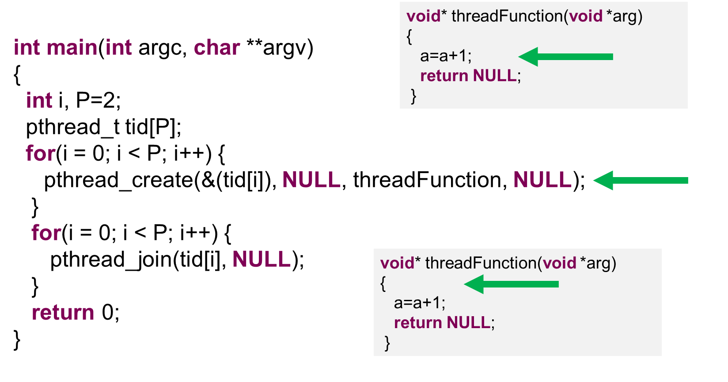
Pthread
Câte thread-uri avem în execuție?

Slide 29
Pthread
Câte thread-uri avem în execuție?
3
main
threadFunction
threadFunction

Slide 30
Pthread
void* threadFunction(void *arg)
{
a=a+1;
return NULL;
}
int main(int argc, char **argv)
{
int i, P=2;
pthread_t tid[P];
for(i = 0; i < P; i++) {
pthread_create(&(tid[i]), NULL, threadFunction, NULL);
}
for(i = 0; i < P; i++) {
pthread_join(tid[i], NULL);
}
return 0;
}
void* threadFunction(void *arg)
{
a=a+1;
return NULL;
}

Slide 31
Pthread
void* threadFunction(void *arg)
{
a=a+1;
return NULL;
}
int main(int argc, char **argv)
{
int i, P=2;
pthread_t tid[P];
for(i = 0; i < P; i++) {
pthread_create(&(tid[i]), NULL, threadFunction, NULL);
}
for(i = 0; i < P; i++) {
pthread_join(tid[i], NULL);
}
return 0;
}
void* threadFunction(void *arg)
{
a=a+1;
return NULL;
}

Slide 32
Pthread
void* threadFunction(void *arg)
{
a=a+1;
return NULL;
}
int main(int argc, char **argv)
{
int i, P=2;
pthread_t tid[P];
for(i = 0; i < P; i++) {
pthread_create(&(tid[i]), NULL, threadFunction, NULL);
}
for(i = 0; i < P; i++) {
pthread_join(tid[i], NULL);
}
return 0;
}
void* threadFunction(void *arg)
{
a=a+1;
return NULL;
}

Slide 33
Pthread
void* threadFunction(void *arg)
{
a=a+1;
return NULL;
}
int main(int argc, char **argv)
{
int i, P=2;
pthread_t tid[P];
for(i = 0; i < P; i++) {
pthread_create(&(tid[i]), NULL, threadFunction, NULL);
}
for(i = 0; i < P; i++) {
pthread_join(tid[i], NULL);
}
return 0;
}
void* threadFunction(void *arg)
{
a=a+1;
return NULL;
}

Slide 34
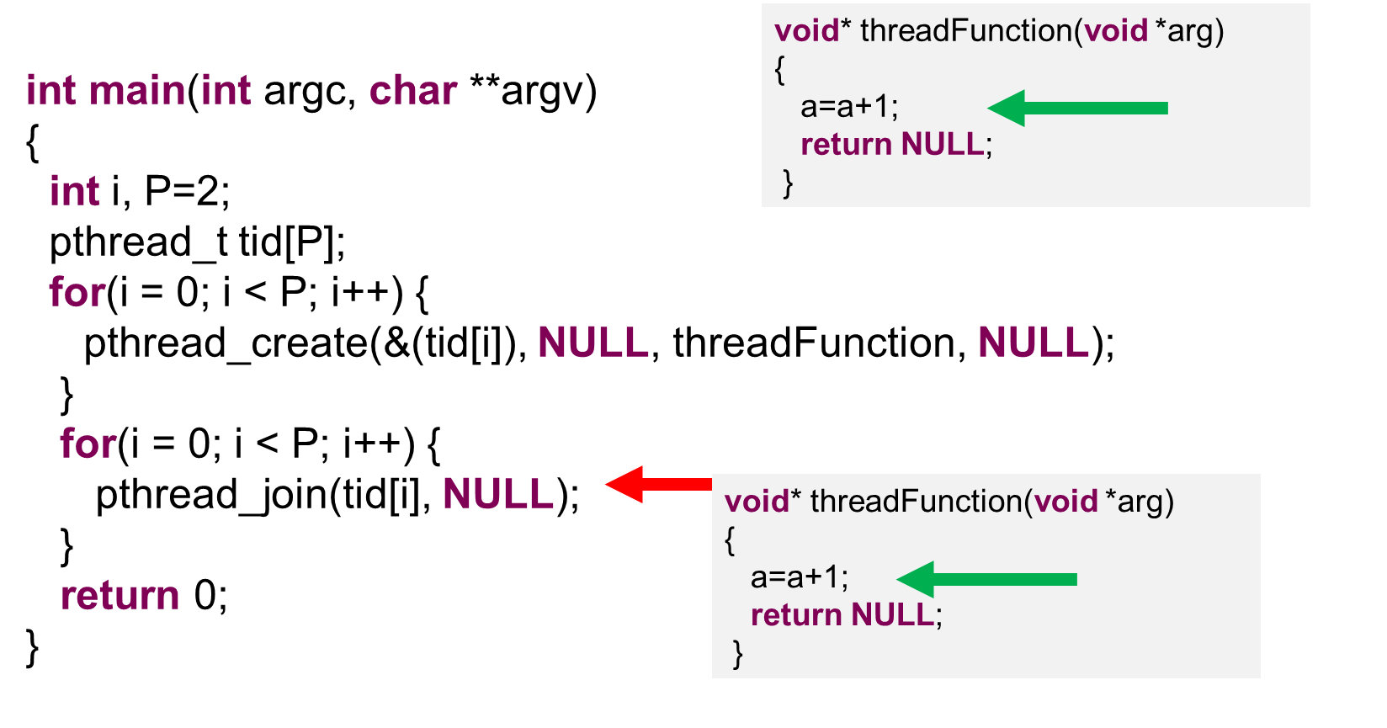
Pthread
Spunem că thread-ul main așteaptă ca thread-ul cu handler-ul tid[i] să termine execuția

Slide 35
Pthread
void* threadFunction(void *arg)
{
a=a+1;
return NULL;
}
int main(int argc, char **argv)
{
int i, P=2;
pthread_t tid[P];
for(i = 0; i < P; i++) {
pthread_create(&(tid[i]), NULL, threadFunction, NULL);
}
for(i = 0; i < P; i++) {
pthread_join(tid[i], NULL);
}
return 0;
}
void* threadFunction(void *arg)
{
a=a+1;
return NULL;
}

Slide 36
Pthread
void* threadFunction(void *arg)
{
a=a+1;
return NULL;
}
int main(int argc, char **argv)
{
int i, P=2;
pthread_t tid[P];
for(i = 0; i < P; i++) {
pthread_create(&(tid[i]), NULL, threadFunction, NULL);
}
for(i = 0; i < P; i++) {
pthread_join(tid[i], NULL);
}
return 0;
}
void* threadFunction(void *arg)
{
a=a+1;
return NULL;
}

Slide 37
Pthread
void* threadFunction(void *arg)
{
a=a+1;
return NULL;
}
int main(int argc, char **argv)
{
int I, P=2;
pthread_t tid[P];
for(i = 0; i < P; i++) {
pthread_create(&(tid[i]), NULL, threadFunction, NULL);
}
for(i = 0; i < P; i++) {
pthread_join(tid[i], NULL);
}
return 0;
}

Slide 38
Pthread
void* threadFunction(void *arg)
{
a=a+1;
return NULL;
}
int main(int argc, char **argv)
{
int I, P=2;
pthread_t tid[P];
for(i = 0; i < P; i++) {
pthread_create(&(tid[i]), NULL, threadFunction, NULL);
}
for(i = 0; i < P; i++) {
pthread_join(tid[i], NULL);
}
return 0;
}

Slide 39
Pthread
void* threadFunction(void *arg)
{
a=a+1;
return NULL;
}
int main(int argc, char **argv)
{
int I, P=2;
pthread_t tid[P];
for(i = 0; i < P; i++) {
pthread_create(&(tid[i]), NULL, threadFunction, NULL);
}
for(i = 0; i < P; i++) {
pthread_join(tid[i], NULL);
}
return 0;
}

Slide 40
Pthread
int main(int argc, char **argv)
{
int I, P=2;
pthread_t tid[P];
for(i = 0; i < P; i++) {
pthread_create(&(tid[i]), NULL, threadFunction, NULL);
}
for(i = 0; i < P; i++) {
pthread_join(tid[i], NULL);
}
return 0;
}

Slide 41
Pthread
int main(int argc, char **argv)
{
int I, P=2;
pthread_t tid[P];
for(i = 0; i < P; i++) {
pthread_create(&(tid[i]), NULL, threadFunction, NULL);
}
for(i = 0; i < P; i++) {
pthread_join(tid[i], NULL);
}
return 0;
}

Slide 42
Pthread
int main(int argc, char **argv)
{
int I, P=2;
pthread_t tid[P];
for(i = 0; i < P; i++) {
pthread_create(&(tid[i]), NULL, threadFunction, NULL);
}
for(i = 0; i < P; i++) {
pthread_join(tid[i], NULL);
}
return 0;
}

Slide 43
Pthread
int main(int argc, char **argv)
{
int I, P=2;
pthread_t tid[P];
for(i = 0; i < P; i++) {
pthread_create(&(tid[i]), NULL, threadFunction, NULL);
}
for(i = 0; i < P; i++) {
pthread_join(tid[i], NULL);
}
return 0;
}

Slide 44
Pthread
int main(int argc, char **argv)
{
int I, P=2;
pthread_t tid[P];
for(i = 0; i < P; i++) {
pthread_create(&(tid[i]), NULL, threadFunction, NULL);
}
for(i = 0; i < P; i++) {
pthread_join(tid[i], NULL);
}
return 0;
}

Slide 45
Pthread
int main(int argc, char **argv)
{
int I, P=2;
pthread_t tid[P];
for(i = 0; i < P; i++) {
pthread_create(&(tid[i]), NULL, threadFunction, NULL);
}
for(i = 0; i < P; i++) {
pthread_join(tid[i], NULL);
}
return 0;
}

Slide 46
Pthread
int main(int argc, char **argv)
{
int I, P=2;
pthread_t tid[P];
for(i = 0; i < P; i++) {
pthread_create(&(tid[i]), NULL, threadFunction, NULL);
}
for(i = 0; i < P; i++) {
pthread_join(tid[i], NULL);
}
return 0;
}

Slide 48
Race condition
Thread 1
Thread 2
a = a + 2
a = a + 2
Care este valoare lui a?

Slide 49
Race condition
a = 0
Thread 1
Thread 2
a = a + 2
a = a + 2
Care este valoare lui a?

Slide 50
Race condition
a = 0
Thread 1
Thread 2
a = a + 2
a = a + 2
Care este valoare lui a?
4

Slide 51
Race condition
a = 0
Thread 1
Thread 2
a = a + 2
a = a + 2
Care este valoare lui a?
4 ȘI 2

Slide 53
Race condition
a = 0
Thread 1
Thread 2
load(a, eax)
eax = eax + 2
write(a, eax)
load(a, eax)
eax = eax + 2
write(a, eax)
eax =
eax =

Slide 54
Race condition
a = 0
Thread 1
Thread 2
load(a, eax)
eax = eax + 2
write(a, eax)
load(a, eax)
eax = eax + 2
write(a, eax)
eax = 0
eax =

Slide 55
Race condition
a = 0
Thread 1
Thread 2
load(a, eax)
eax = eax + 2
write(a, eax)
load(a, eax)
eax = eax + 2
write(a, eax)
eax = 0
eax = 0

Slide 56
Race condition
a = 0
Thread 1
Thread 2
load(a, eax)
eax = eax + 2
write(a, eax)
load(a, eax)
eax = eax + 2
write(a, eax)
eax = 2
eax = 0

Slide 57
Race condition
a = 0
Thread 1
Thread 2
load(a, eax)
eax = eax + 2
write(a, eax)
load(a, eax)
eax = eax + 2
write(a, eax)
eax = 2
eax = 2

Slide 58
Race condition
a = 2
Thread 1
Thread 2
load(a, eax)
eax = eax + 2
write(a, eax)
load(a, eax)
eax = eax + 2
write(a, eax)
eax = 2
eax = 2

Slide 59
Race condition
a = 2
Thread 1
Thread 2
load(a, eax)
eax = eax + 2
write(a, eax)
load(a, eax)
eax = eax + 2
write(a, eax)
eax = 2
eax = 2

Slide 61
Race condition
a = 0
Thread 1
Thread 2
load(a, eax)
eax = eax + 2
write(a, eax)
load(a, eax)
eax = eax + 2
write(a, eax)
eax =
eax =

Slide 62
Race condition
a = 0
Thread 1
Thread 2
load(a, eax)
eax = eax + 2
write(a, eax)
load(a, eax)
eax = eax + 2
write(a, eax)
eax = 0
eax =

Slide 63
Race condition
a = 0
Thread 1
Thread 2
load(a, eax)
eax = eax + 2
write(a, eax)
load(a, eax)
eax = eax + 2
write(a, eax)
eax = 2
eax =

Slide 64
Race condition
a = 2
Thread 1
Thread 2
load(a, eax)
eax = eax + 2
write(a, eax)
load(a, eax)
eax = eax + 2
write(a, eax)
eax = 2
eax =

Slide 65
Race condition
a = 2
Thread 1
Thread 2
load(a, eax)
eax = eax + 2
write(a, eax)
load(a, eax)
eax = eax + 2
write(a, eax)
eax = 2
eax = 2

Slide 66
Race condition
a = 2
Thread 1
Thread 2
load(a, eax)
eax = eax + 2
write(a, eax)
load(a, eax)
eax = eax + 2
write(a, eax)
eax = 2
eax = 4

Slide 67
Race condition
a = 4
Thread 1
Thread 2
load(a, eax)
eax = eax + 2
write(a, eax)
load(a, eax)
eax = eax + 2
write(a, eax)
eax = 2
eax = 4

Slide 69
Race condition
a = 0
Thread 1
Thread 2
load(a, eax)
eax = eax + 2
write(a, eax)
load(a, eax)
eax = eax + 2
write(a, eax)
eax =
eax =

Slide 70
Race condition
a = 0
Thread 1
Thread 2
load(a, eax)
eax = eax + 2
write(a, eax)
load(a, eax)
eax = eax + 2
write(a, eax)
eax = 0
eax = 0

Slide 71
Race condition
a = 0
Thread 1
Thread 2
load(a, eax)
eax = eax + 2
write(a, eax)
load(a, eax)
eax = eax + 2
write(a, eax)
eax = 2
eax = 2

Slide 72
Race condition
a = 2
Thread 1
Thread 2
load(a, eax)
eax = eax + 2
write(a, eax)
load(a, eax)
eax = eax + 2
write(a, eax)
eax = 2
eax = 2

Slide 73
Race condition
a = 2
Thread 1
Thread 2
load(a, eax)
eax = eax + 2
write(a, eax)
load(a, eax)
eax = eax + 2
write(a, eax)
eax = 2
eax = 2

Slide 74
Race condition
a = 2
Thread 1
Thread 2
load(a, eax)
eax = eax + 2
write(a, eax)
load(a, eax)
eax = eax + 2
write(a, eax)
eax = 2
CREW
eax = 2

Slide 76

Primitive de sincronizare Synchronization primitives
Atomics Atomice
Semaphore Semafoare
Binary semaphore (Mutex)
Critical section
Barrier Bariere

Slide 77
Atomics
Fie variabile de 64 biți pe un procesor 64 biți C = A + B
load(A, eax)
load(B, ebx)
eax = eax + ebx
write(C, eax)

Slide 78
Atomics
Fie variabile de 64 biți pe un procesor 32 biți C = A + B
load(A[0], eax)
load(B[0], ebx)
eax = eax + ebx
write(C[0], eax)
load(A[1], eax)
load(B[1], ebx)
eax = eax + ebx
write(C[1], eax)

Slide 79
Atomics
Fie variabile de 64 biți pe un procesor 32 biți C = A + B
load(A[0], eax)
load(B[0], ebx)
eax = eax + ebx
write(C[0], eax)
load(A[1], eax)
load(B[1], ebx)
eax = eax + ebx
write(C[1], eax)
Putem avea doar jumătate de C modificat

Slide 80
Atomics
Fie variabile de 64 biți pe un procesor 32 biți C = A + B
load(A[0], eax)
load(B[0], ebx)
eax = eax + ebx
write(C[0], eax)
load(A[1], eax)
load(B[1], ebx)
eax = eax + ebx
write(C[1], eax)
Atomicitatea asigură că C va fi vizibil doar complet modificat, sau complet nemodificat.

Slide 81
Excludere mutuală Mutual exclusion - mutex

Slide 82
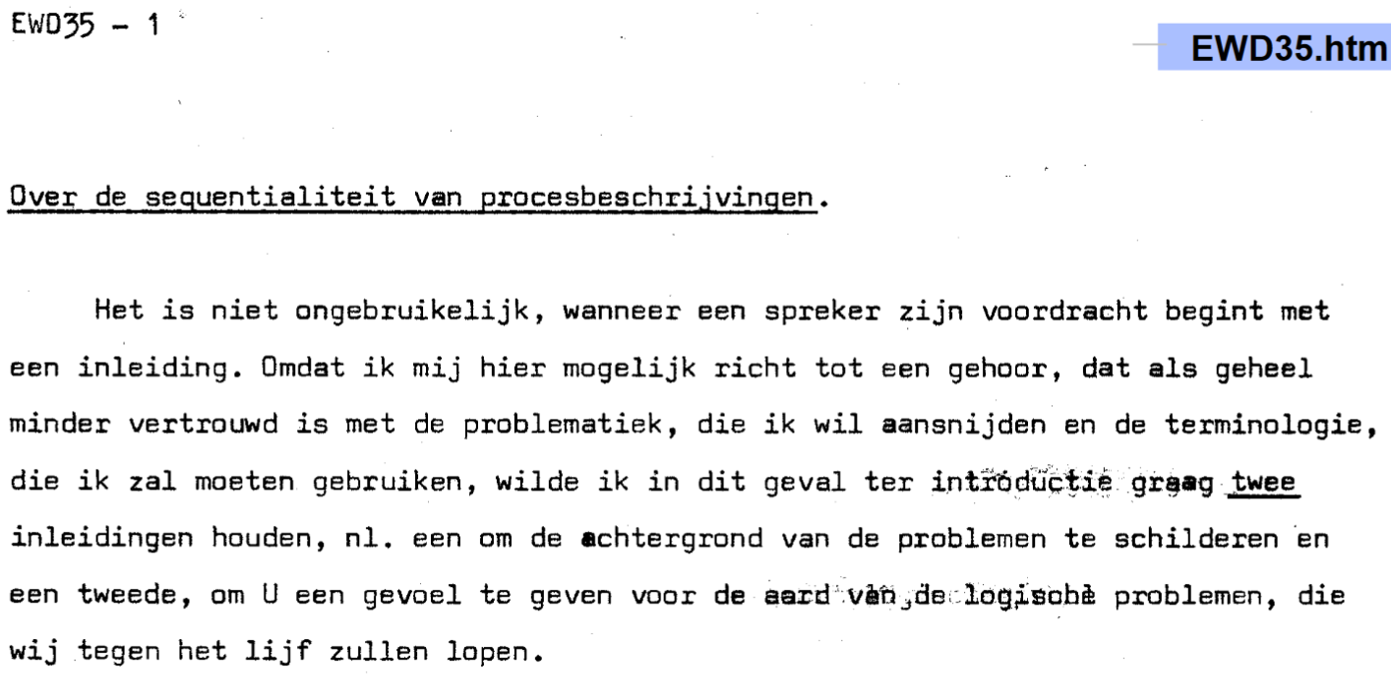

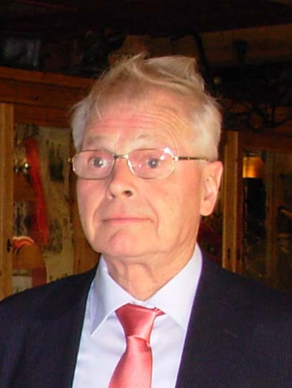
Mutual exclusion - Dekker’s solution
Theodorus (Dirk) J. Dekker
Notes:
1959

Slide 83
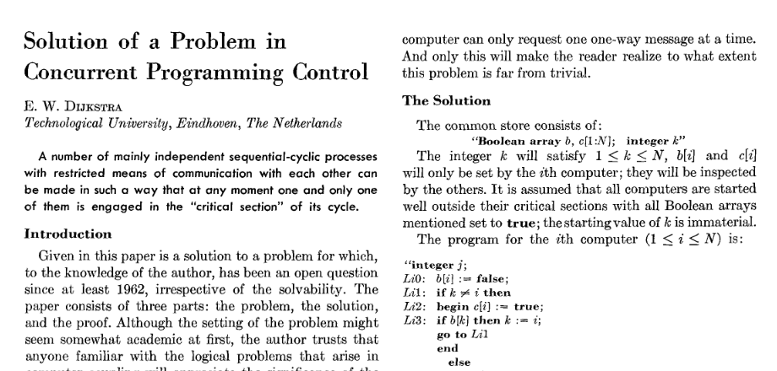
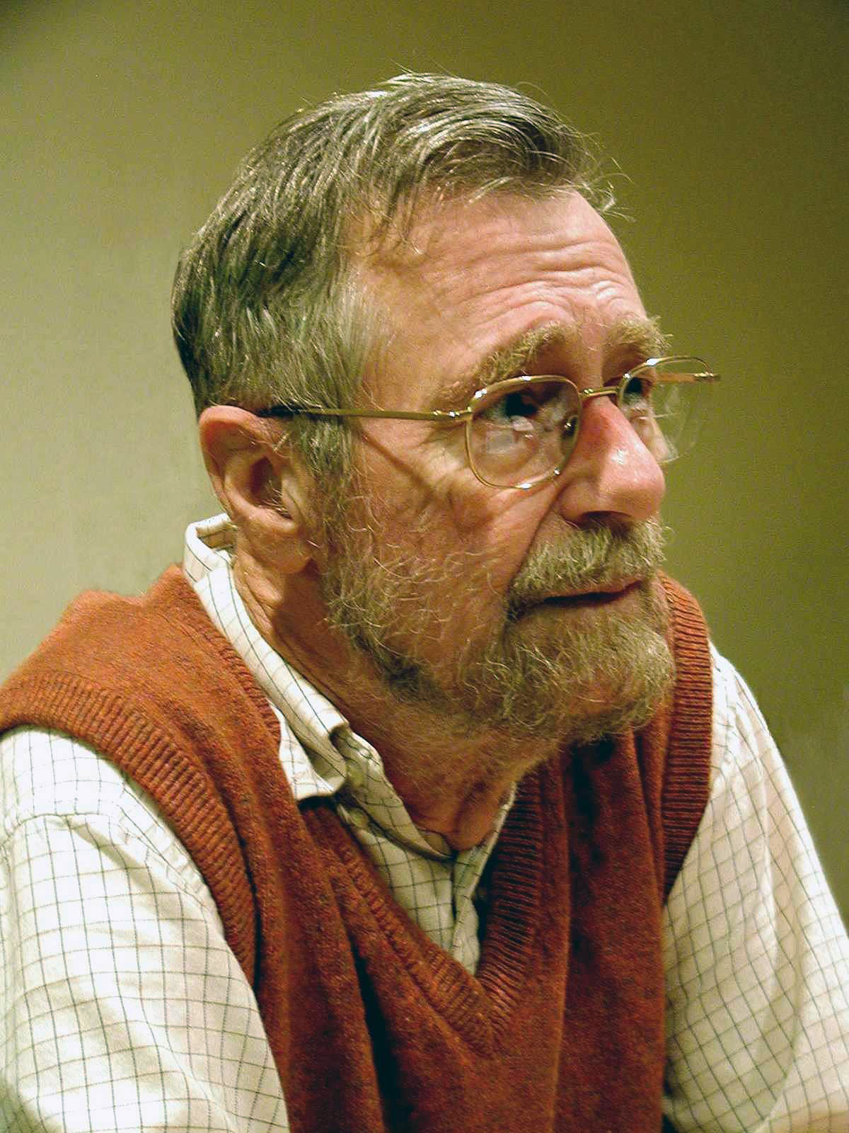
Mutual exclusion – Dijsktra’s Solution
Notes:
1962 – 1963
It works with multiple computers.
http://www.cs.utexas.edu/users/EWD/index01xx.html

Slide 84
Dekker’s Solution
wants_to_enter[0] = true
while wants_to_enter[1] {
if turn != 0 {
wants_to_enter[0] = false
while turn != 0 { // busy wait } wants_to_enter[0] = true
}
}
// critical section ...
turn = 1
wants_to_enter[0] = false

Slide 85
Dijsktra’s Solution
b[i] = false
while(sw[i]) {
sw[i] = false
if (k!=i) {
c[i] = true
if(b[k])
k = i
sw[i] = true
} else {
c[i] = false
for(j=0;j<N;j++)
if(j!=i && !c[j])
sw[i] = true
}
}
//critical
b[i] = true
c[i] = true
lock() - P
unlock() - V

Slide 86
Peterson’s Solution
flag[0] =
;
flag[0] =
;
flag[0] = true;
turn = 1;
while (flag[1] && turn == 1) { // busy wait }
// critical section ...
flag[0] = false;

Slide 87
Hardware assisted Solution
while (test_and_set(lock));
// critical section
lock = 0;

Slide 88
Race condition - solution
a = 0
Thread 1
Thread 2
lock(locka)
load(a, eax)
eax = eax + 2
write(a, eax)
unlock(locka)
lock(locka)
load(a, eax)
eax = eax + 2
write(a, eax)
unlock(locka)
eax = 0
eax = 0

Slide 89
Race condition - solution
?
a = 0
Thread 1
Thread 2
lock(locka)
load(a, eax)
eax = eax + 2
write(a, eax)
unlock(locka)
lock(locka)
load(a, eax)
eax = eax + 2
write(a, eax)
unlock(locka)
eax = 0
eax = 2

Slide 90
Race condition - solution
OK
a = 0
Thread 1
Thread 2
lock(locka)
load(a, eax)
eax = eax + 2
write(a, eax)
unlock(locka)
lock(locka)
load(a, eax)
eax = eax + 2
write(a, eax)
unlock(locka)
eax = 0
eax = 2

Slide 91
Race condition - solution
?
a = 2
Thread 1
Thread 2
lock(locka)
load(a, eax)
eax = eax + 2
write(a, eax)
unlock(locka)
lock(locka)
load(a, eax)
eax = eax + 2
write(a, eax)
unlock(locka)
eax = 0
eax = 2

Slide 92
Race condition - solution
OK
a = 2
Thread 1
Thread 2
lock(locka)
load(a, eax)
eax = eax + 2
write(a, eax)
unlock(locka)
lock(locka)
load(a, eax)
eax = eax + 2
write(a, eax)
unlock(locka)
eax = 0
eax = 2

Slide 93
Race condition - solution
?
a = 0
Thread 1
Thread 2
lock(locka)
load(a, eax)
eax = eax + 2
write(a, eax)
unlock(locka)
lock(locka)
load(a, eax)
eax = eax + 2
write(a, eax)
unlock(locka)
eax = 2
eax = 0

Slide 94
Race condition - solution
OK
a = 0
Thread 1
Thread 2
lock(locka)
load(a, eax)
eax = eax + 2
write(a, eax)
unlock(locka)
lock(locka)
load(a, eax)
eax = eax + 2
write(a, eax)
unlock(locka)
eax = 2
eax = 0

Slide 95
Race condition - solution
?
a = 2
Thread 1
Thread 2
lock(locka)
load(a, eax)
eax = eax + 2
write(a, eax)
unlock(locka)
lock(locka)
load(a, eax)
eax = eax + 2
write(a, eax)
unlock(locka)
eax = 2
eax = 0

Slide 96
Race condition - solution
OK
a = 2
Thread 1
Thread 2
lock(locka)
load(a, eax)
eax = eax + 2
write(a, eax)
unlock(locka)
lock(locka)
load(a, eax)
eax = eax + 2
write(a, eax)
unlock(locka)
eax = 2
eax = 0

Slide 97
Race condition - solution
?
a = 4
Thread 1
Thread 2
lock(locka)
load(a, eax)
eax = eax + 2
write(a, eax)
unlock(locka)
lock(locka)
load(a, eax)
eax = eax + 2
write(a, eax)
unlock(locka)
eax = 2
eax = 2

Slide 98
Race condition - solution
OK
a = 4
Thread 1
Thread 2
lock(locka)
load(a, eax)
eax = eax + 2
write(a, eax)
unlock(locka)
lock(locka)
load(a, eax)
eax = eax + 2
write(a, eax)
unlock(locka)
eax = 2
eax = 2

Slide 99
Race condition - solution
?
a = 0
Thread 1
Thread 2
lock(locka)
load(a, eax)
eax = eax + 2
write(a, eax)
unlock(locka)
lock(locka)
load(a, eax)
eax = eax + 2
write(a, eax)
unlock(locka)
eax = 0
eax = 2

Slide 100
Race condition - solution
a = 0
Thread 1
Thread 2
IMPOSSIBLE
lock(locka)
load(a, eax)
eax = eax + 2
write(a, eax)
unlock(locka)
lock(locka)
load(a, eax)
eax = eax + 2
write(a, eax)
unlock(locka)
eax = 0
eax = 2

Slide 101
Mutex Pthread
ÎN MAIN
Înainte de a porni thread-urile
pthread_mutex_t mutex;
pthread_mutex_init(&mutex, NULL);

Slide 102
Mutex Pthread
pthread_mutex_t mutex;
pthread_mutex_init(&mutex, NULL);
Poate fi folosit să anunțe că acest mutex e împărțit mai multor procese

Slide 103
Mutex Pthread
pthread_mutex_lock(&mutex); load(a, eax)
eax = eax + 2
write(a, eax)
pthread_mutex_unlock(&mutex);

Slide 104
Mutex Pthread
ÎN MAIN
După ce au terminat thread-urile
pthread_mutex_destroy(&mutex);

Slide 106
Semaphore
ÎN MAIN
Înainte de a porni thread-urile
gcc –o executabil cod.c –lpthread –lrt
#include<pthread.h>
#include<semaphore.h>
sem_t semaphore;
int semaphore_value= 4;
sem_init(& semaphore, 0, semaphore_value);

Slide 107


Semaphore
4
sem_wait(&semaphore);
P() sau Proberen
- Dijsktra

Slide 108
Semaphore
4
sem_wait(&semaphore);

Slide 109
Semaphore
4
sem_wait(&semaphore);

Slide 110
Semaphore
3
sem_wait(&semaphore);

Slide 111
Semaphore
Nu contează că doua thread-uri au ajuns simultan la semafor, acesta este protejat, la fel ca un mutex.
2
sem_wait(&semaphore);

Slide 112
Semaphore
1
sem_wait(&semaphore);

Slide 113


Semaphore
0
sem_wait(&semaphore);

Slide 114
Semaphore
0
sem_wait(&semaphore);

Slide 115

Semaphore – A different way of thinking
Un semafor are un set de token-uri.
sem_wait(&semaphore);

Slide 116
Semaphore – A different way of thinking
sem_wait(&semaphore);

Slide 117
Semaphore – A different way of thinking
sem_wait(&semaphore);

Slide 118
Semaphore – A different way of thinking
sem_wait(&semaphore);

Slide 119
Semaphore – A different way of thinking
sem_wait(&semaphore);

Slide 120
Semaphore – Signaling
sem_wait(&semaphore);
-1
sem_post(&semaphore);
sem_post(&semaphore);
V() sau Verogen
- Dijsktra

Slide 121
Semaphore – Signaling
sem_wait(&semaphore);
-1
sem_post(&semaphore);
sem_post(&semaphore);

Slide 122
Semaphore – Signaling
sem_wait(&semaphore);
-1
sem_post(&semaphore);
sem_post(&semaphore);

Slide 123
Semaphore – Signaling
sem_wait(&semaphore);
0
sem_post(&semaphore);
sem_post(&semaphore);

Slide 124
Semaphore – Signaling
sem_wait(&semaphore);
1
sem_post(&semaphore);
sem_post(&semaphore);

Slide 125
Semaphore – Signaling
sem_wait(&semaphore);
0
sem_post(&semaphore);
sem_post(&semaphore);

Slide 126
Semaphore
ÎN MAIN
După ce au terminat thread-urile
sem_destroy(& semaphore);

Slide 127
Barrier

Slide 128
Barrier
ÎN MAIN
Înainte de a porni thread-urile
pthread_barrier_t barrier;
int num_threads = 5;
pthread_barrier_init(&barrier, NULL, num_threads);

Slide 129
Barrier
pthread_barrier_wait(&barrier);
5

Slide 130
Barrier
pthread_barrier_wait(&barrier);
5
Pentru toate thread-urile,
Tot codul de aici
este executat înainte de orice bucata de cod de aici

Slide 131
Barrier
pthread_barrier_wait(&barrier);
5

Slide 132
Barrier
pthread_barrier_wait(&barrier);
5

Slide 133
Barrier
pthread_barrier_wait(&barrier);
5

Slide 134
Barrier
pthread_barrier_wait(&barrier);
3

Slide 135
Barrier
pthread_barrier_wait(&barrier);
2

Slide 136
Barrier
pthread_barrier_wait(&barrier);
1

Slide 137
Barrier
pthread_barrier_wait(&barrier);
1

Slide 138
Barrier
pthread_barrier_wait(&barrier);
1

Slide 139
Barrier
pthread_barrier_wait(&barrier);
1

Slide 140
Barrier
pthread_barrier_wait(&barrier);
0

Slide 141
Barrier
pthread_barrier_wait(&barrier);
0

Slide 142

Barrier
Cum știe o barieră când să se reseteze?
O soluție ar fi:
Reusable Barrier in
The Little Book of Semaphores
By Allen B. Downey
pthread_barrier_wait(&barrier);
5

Slide 143
Barrier
ÎN MAIN
După ce au terminat thread-urile
pthread_barrier_destroy(&barrier);

Slide 145
Unele probleme nu pot fi paralelizate
Calculating the hash of a hash of a hash …
of a string.
Deep First Search
Huffman decoding
Outer loops of most simulations
P complete problems

Slide 146
Paralelizare prin împărțirea problemei
Sunt o serie de probleme care sunt extrem de ușor paralelizabile.
Embarrassingly parallel

Slide 147
Embarrassingly parallel problems
Multiplicare unui vector cu un scalar
9
6
9
4
2
7
6
5
6
1
* 3
27
18
27
12
6
21
18
15
18
3

Slide 148
Embarrassingly parallel problems
Toate calculele pot fi efectuate în același timp
9
6
9
4
2
7
6
5
6
1
* 3
27
18
27
12
6
21
18
15
18
3

Slide 149
Embarrassingly parallel problems
Câte elemente sunt?
9
6
9
4
2
7
6
5
6
1

Slide 150
Embarrassingly parallel problems
Câte elemente sunt?
…
9
6
9
4
2
7
6
5
6
1

Slide 151
Embarrassingly parallel problems
Câte elemente sunt? N
…
9
6
9
4
2
7
6
5
6
1

Slide 152
Embarrassingly parallel problems
Dar câte elemente de procesare?
…
9
6
9
4
2
7
6
5
6
1

Slide 153
Embarrassingly parallel problems
Dar câte elemente de procesare? P
…
9
6
9
4
2
7
6
5
6
1

Slide 154
Embarrassingly parallel problems
Dar câte thread-uri?
…
9
6
9
4
2
7
6
5
6
1

Slide 155
Embarrassingly parallel problems
Dar câte thread-uri? P
…
9
6
9
4
2
7
6
5
6
1
În majoritatea cazurilor obținem performanță maximă când numărul de thread-uri este egal cu numărul de elemente de procesare, sau core-uri.

Slide 156
Embarrassingly parallel problems
Cum este P față de N?
…
9
6
9
4
2
7
6
5
6
1

Slide 157
Embarrassingly parallel problems
P << N
…
9
6
9
4
2
7
6
5
6
1

Slide 158
Embarrassingly parallel problems
Caz concret: P = 2
Cum împărțim?
…
9
6
9
4
2
7
6
5
6
1

Slide 159
Embarrassingly parallel problems
Caz concret: P = 2
Cum împărțim?
…
9
6
9
4
2
7
6
5
6
1
Thread 1
Thread 2

Slide 160
Embarrassingly parallel problems
Caz concret: P = 2
Cum împărțim?
…
9
6
9
4
2
7
6
5
6
1
Thread 1
Thread 2

Slide 161
Embarrassingly parallel problems
Caz concret: P = 2
Cum împărțim?
…
9
6
9
4
2
7
6
5
6
1
Thread 1
Thread 2

Slide 162
Embarrassingly parallel problems
Caz concret: P = 2
Cum împărțim? Putem și random
…
9
6
9
4
2
7
6
5
6
1
Thread 1
Thread 2

Slide 163
Embarrassingly parallel problems
Caz concret: P = 2
Cum împărțim?
…
9
6
9
4
2
7
6
5
6
1
Thread 1
Thread 2

Slide 164
Embarrassingly parallel problems
Caz concret: P = 2
Cum împărțim?
Este utilă?
…
9
6
9
4
2
7
6
5
6
1
Thread 1
Thread 2

Slide 165
Embarrassingly parallel problems
Caz concret: P = 2
Cum împărțim?
Ce ne dorim?
…
9
6
9
4
2
7
6
5
6
1
Thread 1
Thread 2

Slide 166
Embarrassingly parallel problems
Caz concret: P = 2
Cum împărțim?
Ce ne dorim?
Aproximativ același număr elemente
…
9
6
9
4
2
7
6
5
6
1
Thread 1
Thread 2

Slide 167
Embarrassingly parallel problems
Aproximativ N/P elemente
…
9
6
9
4
2
7
6
5
6
1
Thread 1
Thread 2

Slide 168
Embarrassingly parallel problems
Aproximativ N/P elemente
Dacă N nu se divide perfect la P?
…
9
6
9
4
2
7
6
5
6
1
Thread 1
Thread 2

Slide 169
Embarrassingly parallel problems
Aproximativ N/P elemente
Dacă N nu se divide perfect la P?
1
6
8
4
2
7
4
9
2
9
6
9
5
6
3
Thread 1
Thread 2

Slide 170
Embarrassingly parallel problems
floor(N/P) elemente floor(15/2) = 7
1
6
8
4
2
7
4
9
2
9
6
9
5
6
3
Thread 1
Thread 2

Slide 171
Embarrassingly parallel problems
ceil(N/P) elemente ceil(15/2) = 8
6
5
8
1
4
2
7
4
9
2
9
6
9
6
3
Thread 1
Thread 2

Slide 172
Embarrassingly parallel problems
A = floor(N/P)
PA
0
A
2A
N

Slide 173
Embarrassingly parallel problems
A = ceil(N/P)
PA
0
A
2A
N

Slide 174
Embarrassingly parallel problems
Formule elegante:
Tid este identificator de thread, are valori de la 0 la P
start = Tid * ceil(N/P)
end = min(N, (Tid+1) * ceil(N/P))
PA
0
A
2A
N

Slide 175
Embarrassingly parallel problems
Formule elegante:
Tid este identificator de thread, are valori de la 0 la P
start = Tid * ceil(N/P)
end = min(N, (Tid+1) * ceil(N/P))
PA
0
A
2A
N
Funcționează și:
start = round(Tid * N/P)
end = round((Tid+1) * N/P) De ce?

